Slide 1
Cognitive Services: Custom Vision Service & APIs
Chris Testa-O’Neill
Data Scientist
AI and Research Team
Notes:
This session is brought to you by Microsoft’s Artificial Intelligence and Research Team.

Slide 2

Agenda
Cognitive Services Introduction
Custom Vision Overview
Custom Vision APIs
Creating Custom Vision Solution
Notes:
At the end of this Module, you will:
Cognitive Services Introduction
Custom Vision Overview
Custom Vision APIs
Creating Custom Vision Solution

Slide 3
Cognitive Services Introduction
Notes:
This section of the course will cover:
What is Cognitive Services
Cognitive Services Capabilities
Cognitive Services Capability breakdown
Cognitive Services –Vision APIs

Slide 4







Why Microsoft Cognitive Services ?
Easy
Flexible
Tested
Roll your own with REST APIs
Simple to add: just a few lines of code required
Make the same API code call on iOS, Android, and Windows
Integrate into the language and platform of your choice
Built by experts in their field from Microsoft Research, Bing, and Azure Machine Learning
Quality documentation, sample code, and community support
GET A KEY
BUILD
Notes:
With Cognitive Services, you can infuse your apps, websites and bots with intelligent algorithms to see, hear, speak, understand and interpret your user needs through natural methods of communication.
Transform your business with AI today.
Reference:
https://azure.microsoft.com/en-gb/services/cognitive-services/

Slide 5

Vision
From faces to feelings, allow your apps to understand images and video
Microsoft Cognitive Services
Give your apps a human side
Speech
Hear and speak to your users by filtering noise, identifying speakers, and understanding intent
Language
Process text and learn how to recognize what users want
Knowledge
Tap into rich knowledge amassed from the web, academia, or your own data
Search
Access billions of web pages, images, videos, and news with the power of Bing APIs
Notes:
Manage Cognitive Services in the Azure Cloud or test them with temporary access.
Reference:
https://azure.microsoft.com/en-gb/services/cognitive-services/directory/

Slide 6
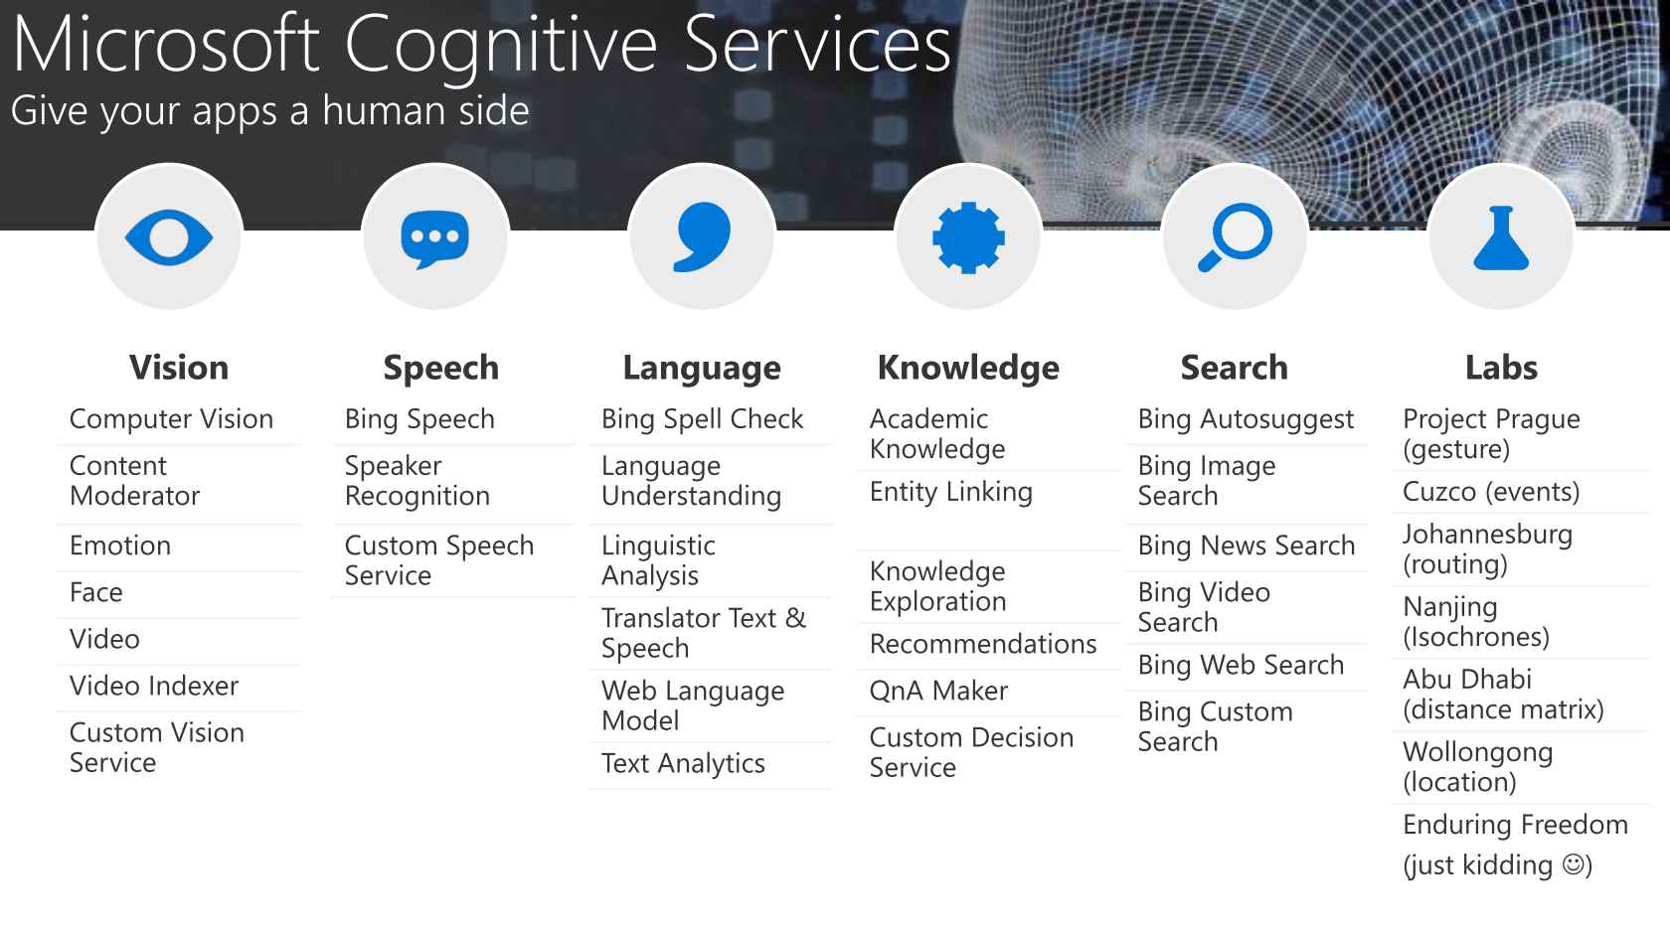

Cognitive Services microsoft.com/cognitive
Vision
Speech
Language
Knowledge
Search
Computer Vision
Custom Recognition
Bing Spell Check
Academic Knowledge
Bing
Web Search
Face
Speaker Recognition
Linguistic Analysis
Entity Linking
Bing
Image Search
Video
Bing Speech
Language Understanding
Knowledge Exploration
Bing
Video Search
Content Moderator
Translator
Text Analytics
Recommendations
Bing
News Search
Custom Vision
WebLM
Bing
Autosuggest
Notes:
Use AI to add intelligence to your applications with:
Vision
Image-processing algorithms to smartly identify, caption and moderate your pictures.
Speech
Convert spoken audio into text, use voice for verification, or add speaker recognition to your app.
Knowledge
Map complex information and data in order to solve tasks such as intelligent recommendations and semantic search.
Search
Add Bing Search APIs to your apps and harness the ability to comb billions of webpages, images, videos, and news with a single API call.
Language
Allow your apps to process natural language with pre-built scripts, evaluate sentiment and learn how to recognize what users want.
Reference:
https://azure.microsoft.com/en-gb/services/cognitive-services/

Slide 7
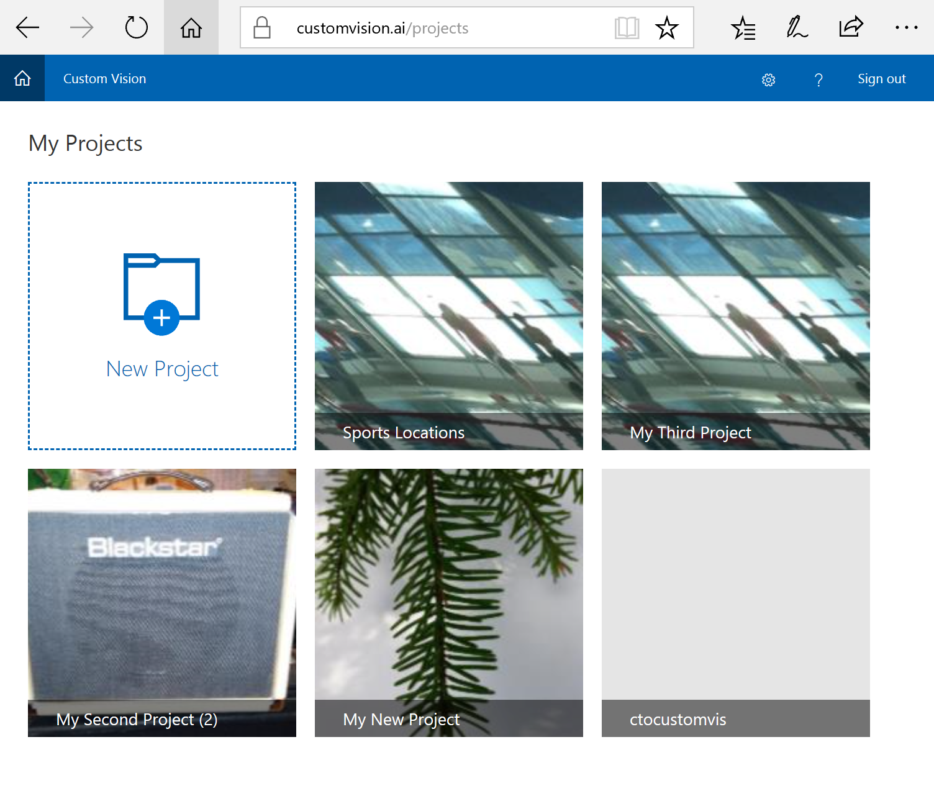
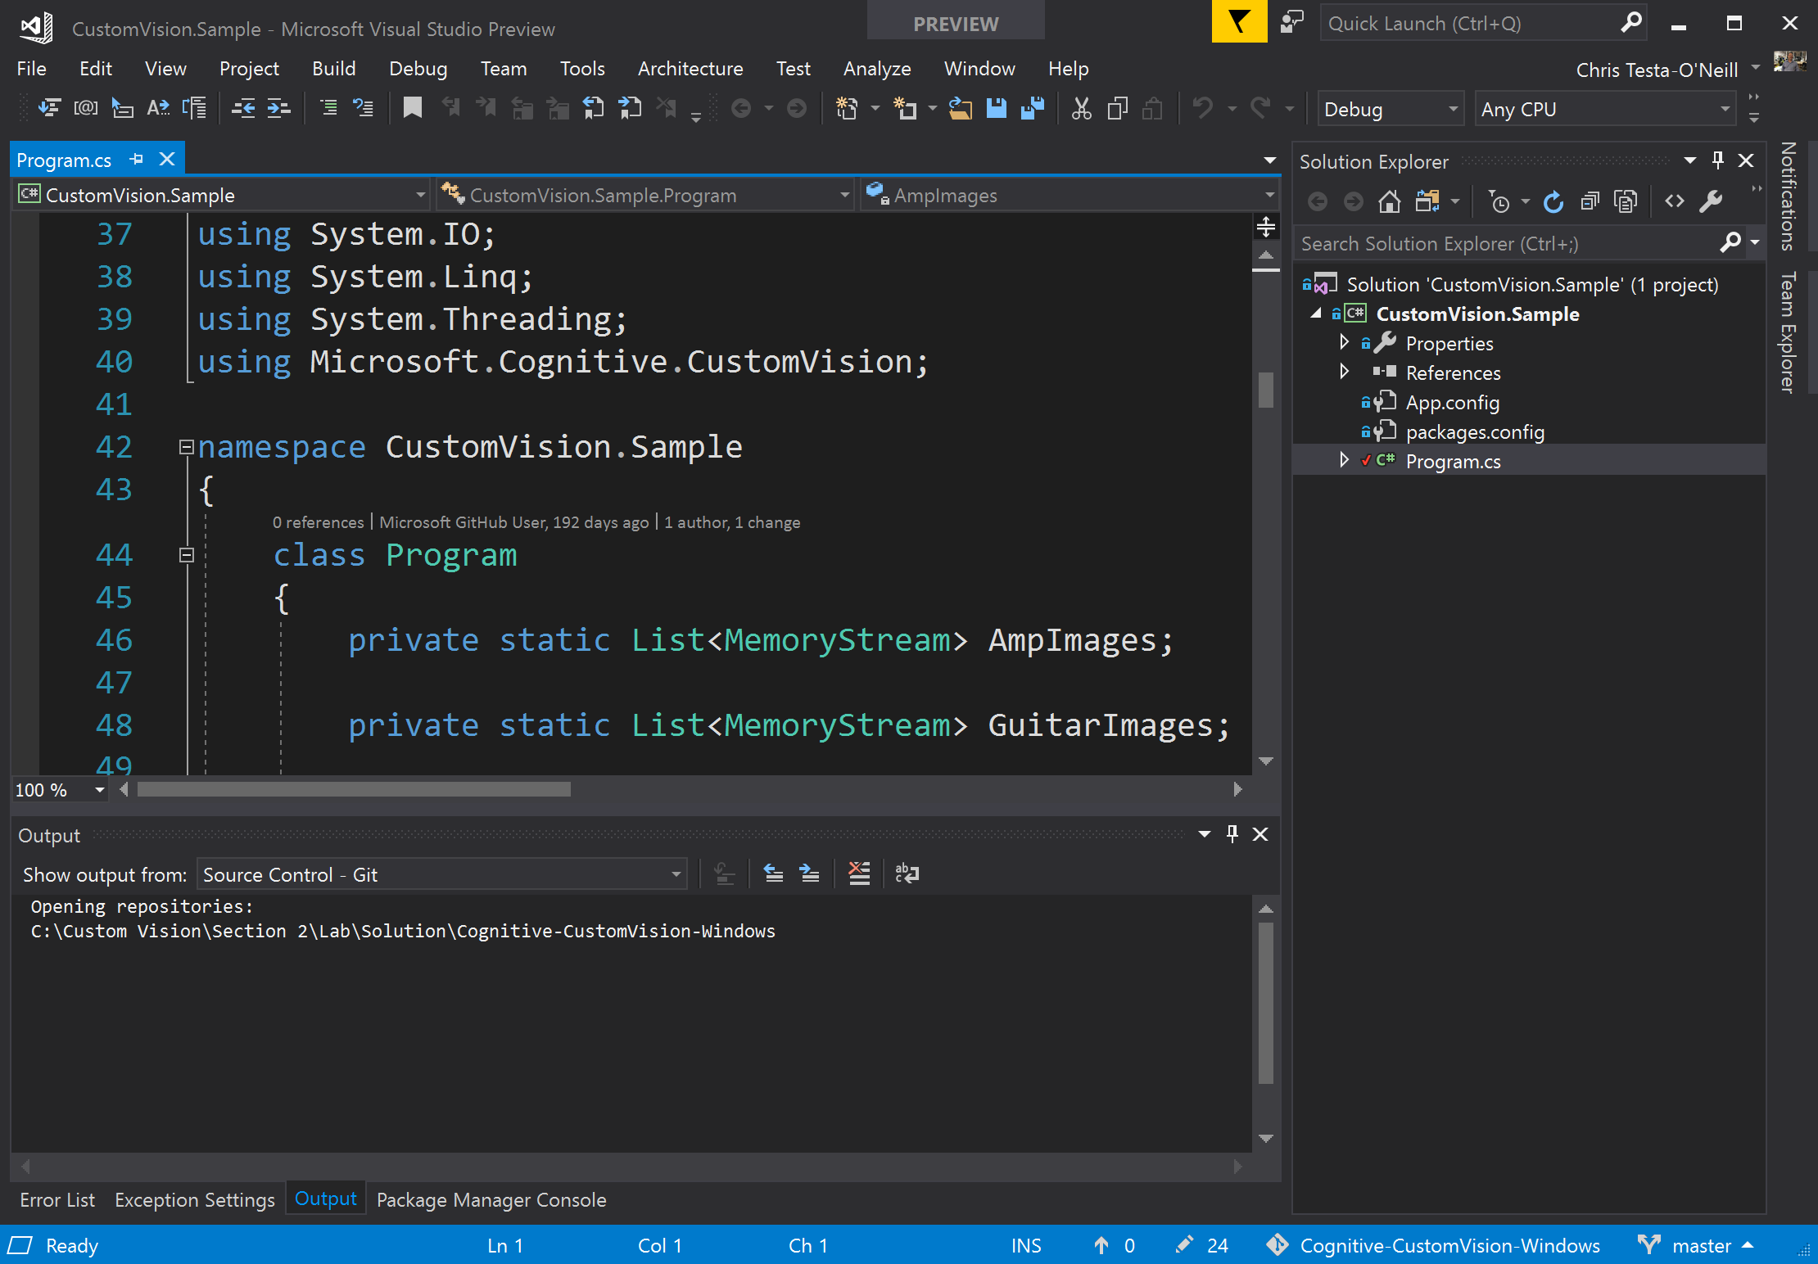
Cognitive Services – Vision APIs
Vision
Computer Vision
Face
Video
Content Moderator
Custom Vision
Notes:
Cognitive Services has a number of API’s around vision including:
Custom Vision Service
PREVIEW Easily customise your own state-of-the-art computer vision models for your unique use case
Try Custom Vision Service
Computer Vision API
Distill actionable information from images
Try Computer Vision API | Use with an Azure subscription
Face API
Detect, identify, analyse, organise and tag faces in photos
Try Face API | Use with an Azure subscription
Content moderator
Automated image, text and video moderation
Use with an Azure subscription
Emotion API
PREVIEW Personalise user experiences with emotion recognition
Try Emotion API | Use with an Azure subscription
Video API
PREVIEW Intelligent video processing
Use with an Azure subscription
Video Indexer
PREVIEW Unlock video insights
Try Video Indexer
Reference:
https://azure.microsoft.com/en-gb/services/cognitive-services/directory/vision/

Slide 8
Custom Vision Overview
Notes:
This section of the course will cover:
What is Custom Vision
Custom Vision Process
Prerequisites for Custom Vision
Using the Custom Vision website

Slide 9

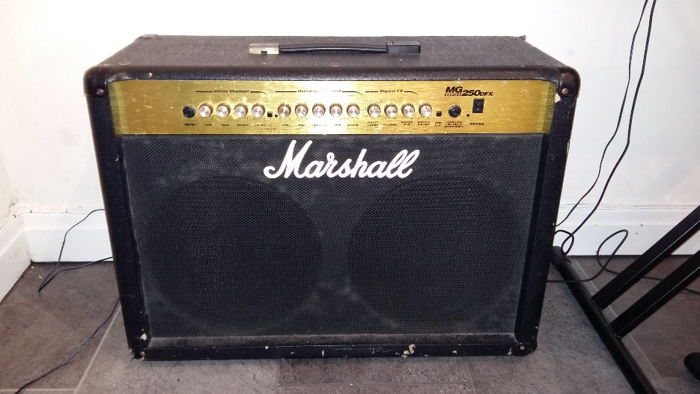
What is Custom Vision
Tool for building custom image classifiers.
REST API and a web interface provided to upload your images and train.
Very few images are required to create a classifier – 30 should be enough.
Object detection included with training.
The quality of your classifier will improve over time
Classifier: Amp
Classifier: Guitar
Notes:
Custom Vision Service brings the power of machine learning to your apps.
Custom Vision Service is a tool for building custom image classifiers. It makes it easy and fast to build, deploy, and improve an image classifier. We provide a REST API and a web interface to upload your images and train.
Reference:
https://docs.microsoft.com/en-gb/azure/cognitive-services/custom-vision-service/home

Slide 10
Custom Vision Process
Upload Images
Build and Model
Prediction API
Consume Model
Tag/Classify images
Evaluate Classifier Results
Train the Classifier
Test the Classifier
Notes:
The following process is followed to make use of the custom vision service.
Upload images
Build and Model the images
Tag/Classify the images.
Train the Classifier.
Test the Classifier.
Evaluate the Classifier results
Generate a Prediction API
Consume the generated model
Step 2. Build and Modelling the images is an iterative process, that can be used to improve the models prediction performance. There are addition ways in which you can improve the classifier as found at the following link:
https://docs.microsoft.com/en-gb/azure/cognitive-services/custom-vision-service/getting-started-improving-your-classifier
In addition, this work can be performed graphically at the http://computervision.ai website, or programmatically through the Custom Vision APIs

Slide 11
Prerequisites for Custom Vision
A valid Microsoft account or Azure Active Directory OrgID
A series of images to train the classifier
A few images to test the classifier after training
Note: the lab will only use 10 images per classifier to minimize lab time
Notes:
To use the Custom Vision Service you must first build a classifier.
Prerequisites
To build a classifier, you must first have:
A valid Microsoft Account or an Azure Active Directory OrgID ("work or school account"), so you can sign into customvision.ai and get started. Note that OrgID login for AAD users from national clouds is not currently supported.
A series of images to train your classifier (minimum of 30 images per tag).
A few images to test your classifier after the classifier is trained.
Reference:
https://docs.microsoft.com/en-gb/azure/cognitive-services/custom-vision-service/getting-started-build-a-classifier

Slide 12
Demo: Using the Customvision.ai Website
Notes:
In this demonstration, you will see how to use the Computervision.ai website to classify, train and predict images that are uploaded to the website.

Slide 13
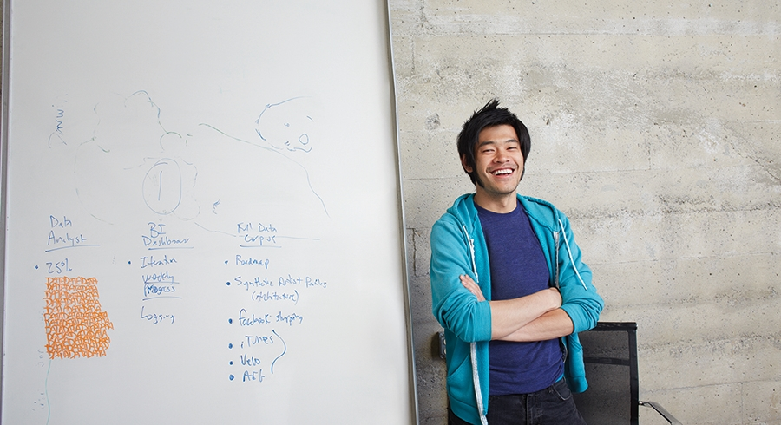


Lab 1:
Using the Custom Vision website.
Notes:
Custom Vision Tutorial
Explore a basic Windows application that uses the Computer Vision API to create a project; add tags to it; upload images; train the project; obtain the default prediction endpoint URL for the project; and use the endpoint to programmatically test an image. You can use this open source example as a template for building your own app for Windows using the Custom Vision API.
Prerequisites
Platform requirements
Access to a browser and a login to the https://customvision.ai website
Lab: Using a Custom Vision Application
Step 1: Log into the customvision.ai website and create a new project named Sport Location, and upload images
Open up your browser.
type in https://customvision.ai and sign in or register.
Click on the icon for New Project
In the New Project dialog box, type the name Sports Locations, and click on Create Project.
In the web page, click on the button Add images, then click on the button Browse local files. browse to the location \Lab\Starter\Images. select all the images and click on Open.
Click on Upload 20 files.
Click Done.
Step 2: Add tags to the images in the project
In the webpage, click on the check box next to untagged.
Hover over a picture that looks like a swimming pool, and click on the tick that appears in the picture. Repeat for each swimming pool image.
On the toolbar, click on Tag images.
In the Tag Images dialog box, in the text box, type Pools, and then click on the plus icon and click on Save and close.
Hover over a picture that looks like an athletics track, and click on the tick that appears in the picture. Repeat for each athletics track image.
On the toolbar, click on Tag images.
In the Tag Images dialog box, in the text box, type Tracks, and then click on the plus icon and click on Save and close.
Step 3: Train the project
In the web page, at the top right, click on the green button that states Train.
The Performance web page shows a title of iteration 1 with figures pertaining to the precision and recall values of the trained model.
Step 4: Perform a prediction
In the web page, at the top right, click on the blue button that states Quick Test.
In the Quick Test dialog box, click on Browse local files, browse to the location \Lab\Starter\Test. select the image Sport.jpg and click on Open.
The result will appear after about 10 seconds confirming that the picture is a Pool with 100% Probability

Slide 14
Custom Vision APIs
Notes:
This section of the course will cover:
Types of Custom Vision Client Library’s
Obtaining a training key
Creating stores in memory
API instantiation and Credential Management
Handling Credential Input
Loading images into memory
Creating a Project
Managing Tagging
Uploading Images
Training the model
Making Predictions

Slide 15
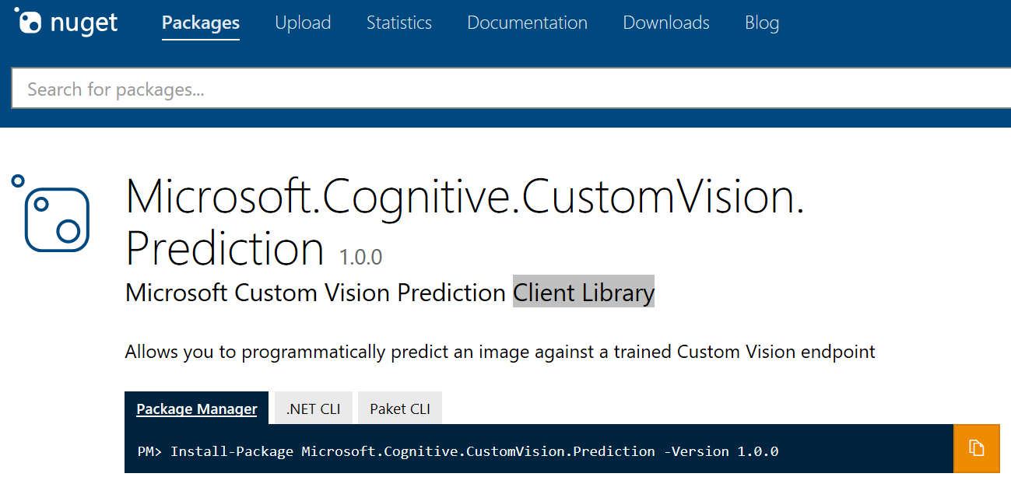
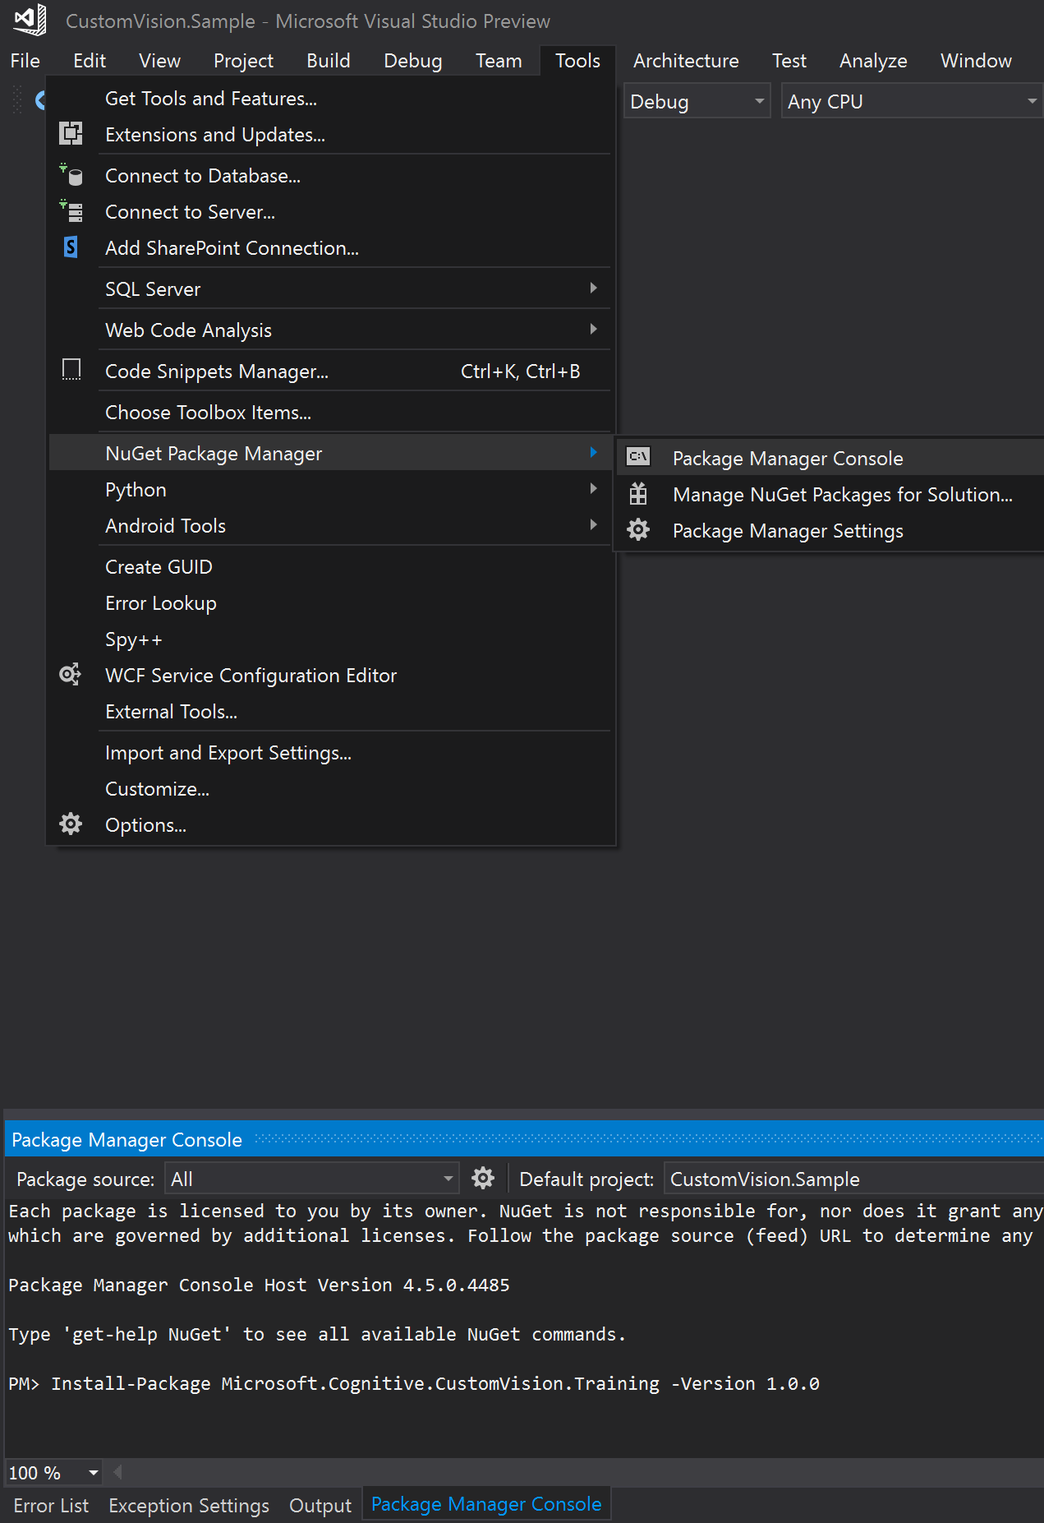
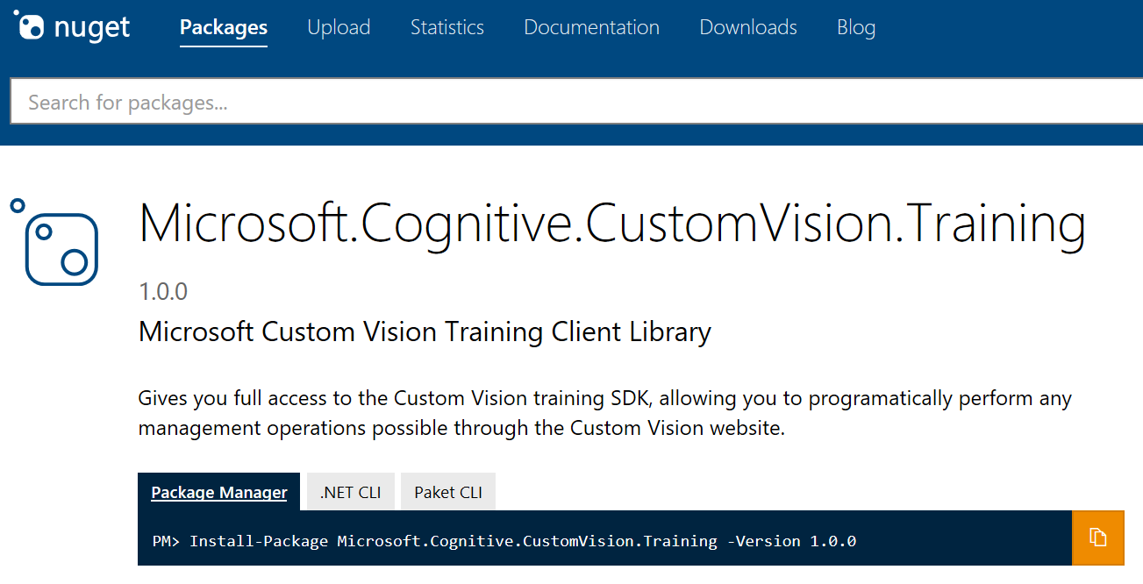
Type of Custom Vision Client Library’s
Notes:
Two client libraries that can be used to develop a Custom Vision application:
Microsoft.Cognitive.CustomVision.Training
Gives you full access to the Custom Vision training SDK, allowing you to programatically perform any management operations possible through the Custom Vision website.
Reference:
https://www.nuget.org/packages/Microsoft.Cognitive.CustomVision.Training/
Microsoft.Cognitive.CustomVision.Prediction
Allows you to programmatically predict an image against a trained Custom Vision endpoint.
Reference:
https://www.nuget.org/packages/Microsoft.Cognitive.CustomVision.Prediction/

Slide 16
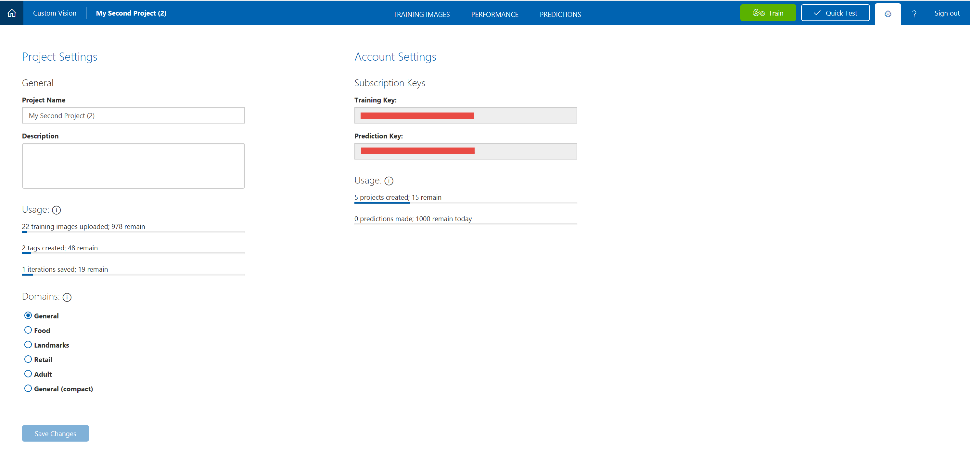
Obtaining a training key
Notes:
A training key will be required to use the https://customvision.ai service programmatically.
Open up your browser.
type in https://customvision.ai and sign in or register.
Click on the icon for New Project
Click on the Project Settings icon
Under Subscription Keys, copy the key

Slide 17
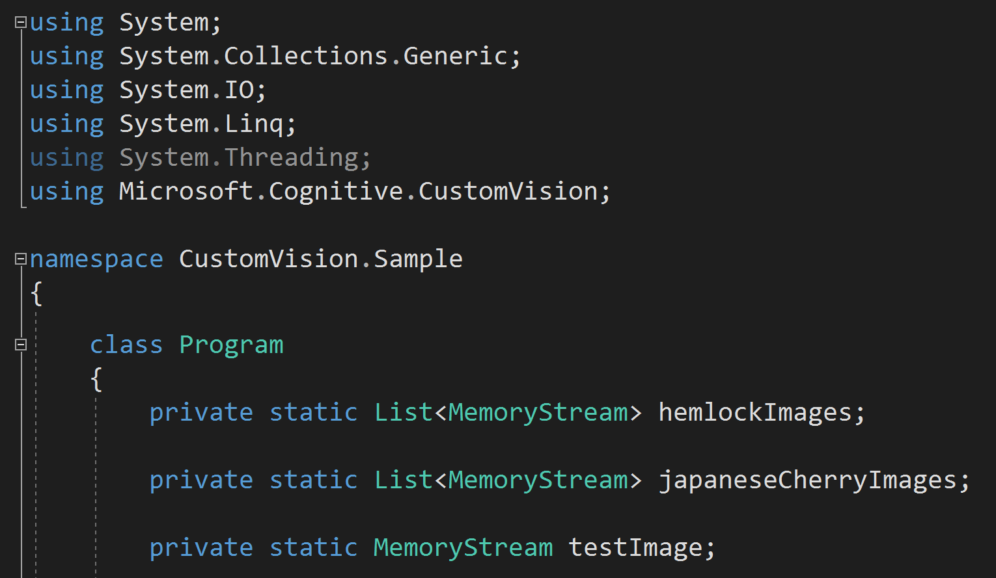
Creating stores in memory
Notes:
This page has been intentionally left blank.
The instructor will walk through the code either from the PowerPoint slide or from the source code in Visual Studio.

Slide 18
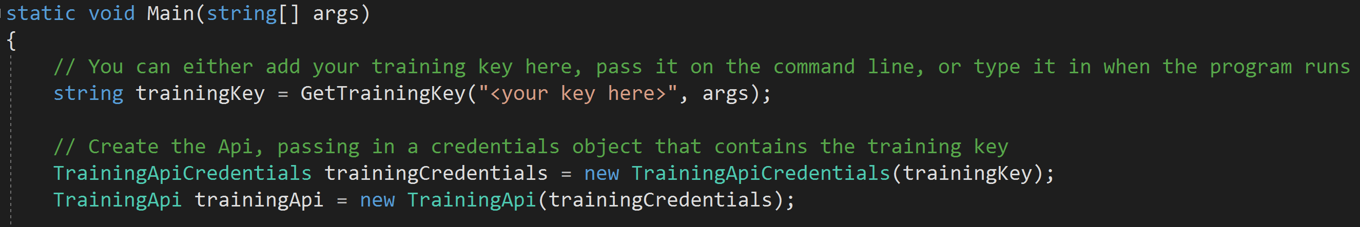
API Instantiation and Credentials Management
Notes:
This page has been intentionally left blank.
The instructor will walk through the code either from the PowerPoint slide or from the source code in Visual Studio.

Slide 19
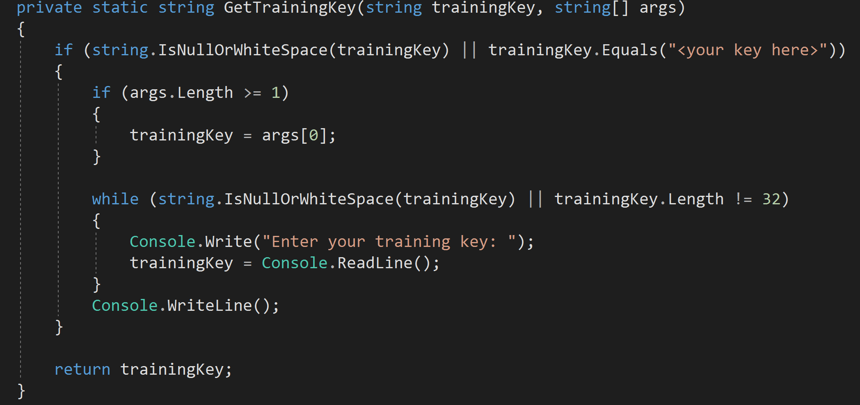
Handling Credential Input
Notes:
This page has been intentionally left blank.
The instructor will walk through the code either from the PowerPoint slide or from the source code in Visual Studio.

Slide 20
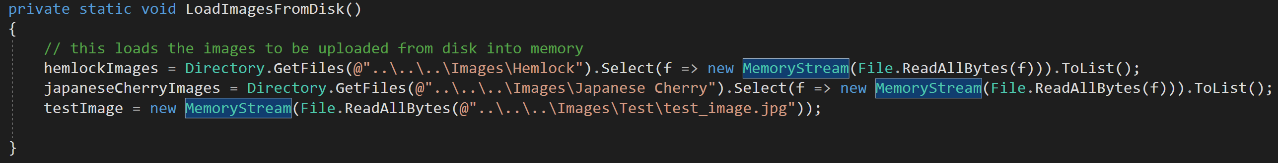
Loading Images into Memory
Notes:
This page has been intentionally left blank.
The instructor will walk through the code either from the PowerPoint slide or from the source code in Visual Studio.

Slide 21
Demo: Setting up Custom Vision Programmatically
Notes:
In this demonstration we will look at the code required to prepare to use the Custom Vision APIs.
Prerequisites
Platform requirements
This example has been developed for the .NET Framework using Visual Studio 2017, Community Edition
Training client library
You may need to install the client library. The easiest way to get the training client library is to get the Microsoft.Cognitive.CustomVision.Training package from nuget.
The Training API key
The training API key allows you to create, manage and train Custom Vision projects programatically. All operations on the website are exposed through this library, allowing you to automate all aspects of the Custom Vision Service. You can obtain a key by creating a project at at the website and finding the key in the setting of the project that you have created.
Step 1: Setting up Custom Vision Programmatically
Start Visual Studio 2017, Community Edition, open the Visual Studio solution named CustomVision.Sample.sln in location \Lab\Starter\Cognitive-CustomVision-Windows\Samples\CustomVision.Sample. This code defines and calls two helper methods. The method called GetTrainingKey prepares the training key. The one called LoadImagesFromDisk loads two sets of images that this example uses to train the project, and one test image that the example loads to demonstrate the use of the default prediction endpoint. On opening the project the following code should be displayed from line 35. Review the folowing code with the students:
using System;
using System.Collections.Generic;
using System.IO;
using System.Linq;
using System.Threading;
using Microsoft.Cognitive.CustomVision;
namespace CustomVision.Sample
{
class Program
{
private static List<MemoryStream> hemlockImages;
private static List<MemoryStream> japaneseCherryImages;
private static MemoryStream testImage;
static void Main(string[] args)
{
// You can either add your training key here, pass it on the command line, or type it in when the program runs
string trainingKey = GetTrainingKey("<your key here>", args);
// Create the Api, passing in a credentials object that contains the training key
TrainingApiCredentials trainingCredentials = new TrainingApiCredentials(trainingKey);
TrainingApi trainingApi = new TrainingApi(trainingCredentials);
}
private static string GetTrainingKey(string trainingKey, string[] args)
{
if (string.IsNullOrWhiteSpace(trainingKey) || trainingKey.Equals("<your key here>"))
{
if (args.Length >= 1)
{
trainingKey = args[0];
}
while (string.IsNullOrWhiteSpace(trainingKey) || trainingKey.Length != 32)
{
Console.Write("Enter your training key: ");
trainingKey = Console.ReadLine();
}
Console.WriteLine();
}
return trainingKey;
}
private static void LoadImagesFromDisk()
{
// this loads the images to be uploaded from disk into memory
hemlockImages = Directory.GetFiles(@"..\..\..\Images\Hemlock").Select(f => new MemoryStream(File.ReadAllBytes(f))).ToList();
japaneseCherryImages = Directory.GetFiles(@"..\..\..\Images\Japanese Cherry").Select(f => new MemoryStream(File.ReadAllBytes(f))).ToList();
testImage = new MemoryStream(File.ReadAllBytes(@"..\..\..\Images\Test\test_image.jpg"));
}
}
}

Slide 22
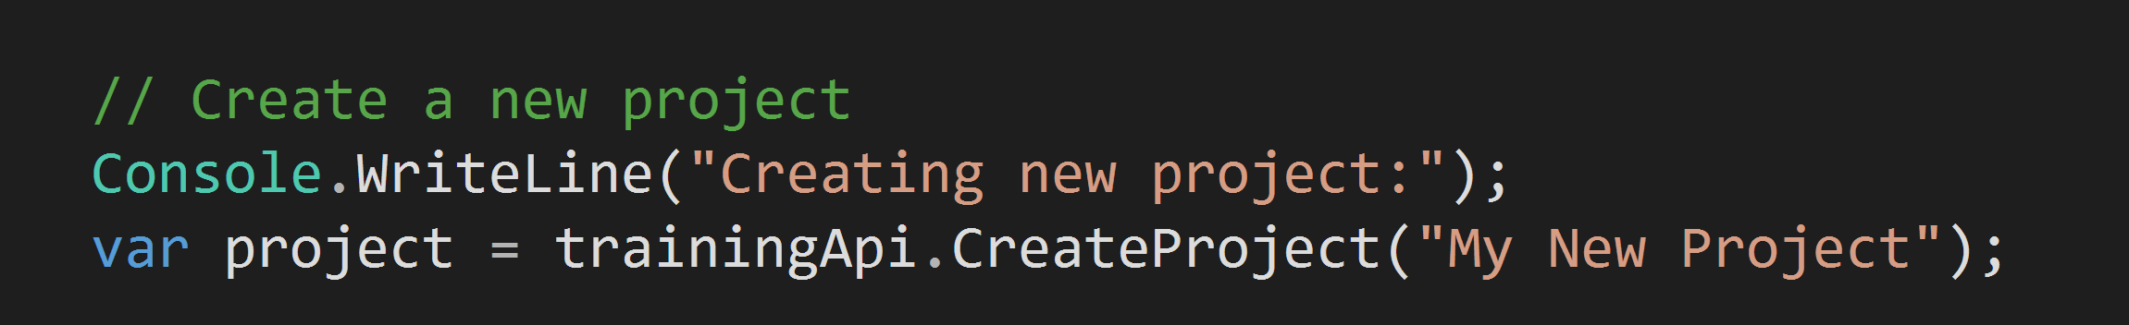
Creating a Project
Notes:
This page has been intentionally left blank.
The instructor will walk through the code either from the PowerPoint slide or from the source code in Visual Studio.

Slide 23
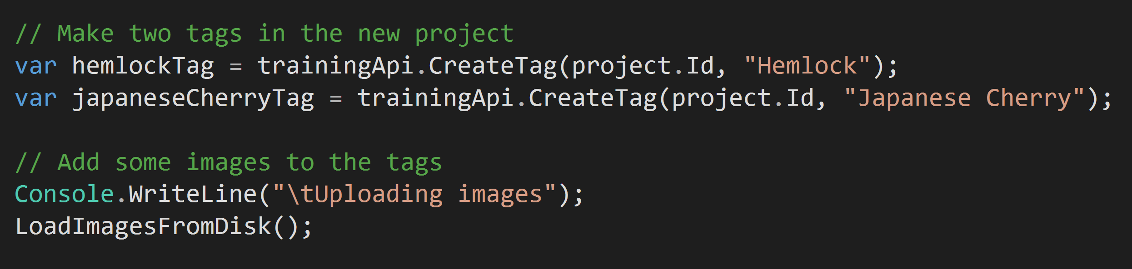
Managing Tagging
Notes:
This page has been intentionally left blank.
The instructor will walk through the code either from the PowerPoint slide or from the source code in Visual Studio.

Slide 24
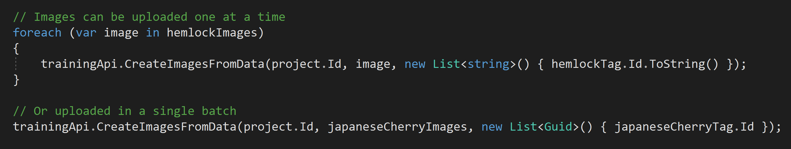
Uploading Images
Notes:
This page has been intentionally left blank.
The instructor will walk through the code either from the PowerPoint slide or from the source code in Visual Studio.

Slide 25
Demo: Creating Custom Vision Projects and Image Management
Notes:
In this demonstration, you will see the C# code required to create a Custom Vision Project, create tags and associate images to the tags before uploading the images.
Prerequisites
Previous demo completed
Ensure that the previous demo has been completed
Platform requirements
This example has been developed for the .NET Framework using Visual Studio 2017, Community Edition
Training client library
You may need to install the client library. The easiest way to get the training client library is to get the Microsoft.Cognitive.CustomVision.Training package from nuget.
The Training API key
The training API key allows you to create, manage and train Custom Vision projects programatically. All operations on the website are exposed through this library, allowing you to automate all aspects of the Custom Vision Service. You can obtain a key by creating a project at at the website and finding the key in the setting of the project that you have created. Add the following code as instructed to the code you opened up in the previous demo.
Step 2: Create a Custom Vision Service project
To create a new Custom Vision Service project, add the following code in your Main() method after the call to LoadImagesFromDisk().
// Create a new project
Console.WriteLine("Creating new project:");
var project = trainingApi.CreateProject("My New Project");
Step 3: Add tags to your project
To add tags to your project, insert the following code after the call to CreateProject(”My New Project”);.
// Make two tags in the new project
var hemlockTag = trainingApi.CreateTag(project.Id, "Hemlock");
var japaneseCherryTag = trainingApi.CreateTag(project.Id, "Japanese Cherry");
Step 4: Upload images to the project
To add the images we have in memory to the project, insert the following code after the call to CreateTag(project.Id, "Japanese Cherry") method.
// Add some images to the tags
Console.WriteLine("\tUploading images");
LoadImagesFromDisk();
// Images can be uploaded one at a time
foreach (var image in hemlockImages)
{
trainingApi.CreateImagesFromData(project.Id, image, new List<string>() { hemlockTag.Id.ToString() });
}
// Or uploaded in a single batch
trainingApi.CreateImagesFromData(project.Id, japaneseCherryImages, new List<Guid>() { japaneseCherryTag.Id });

Slide 26
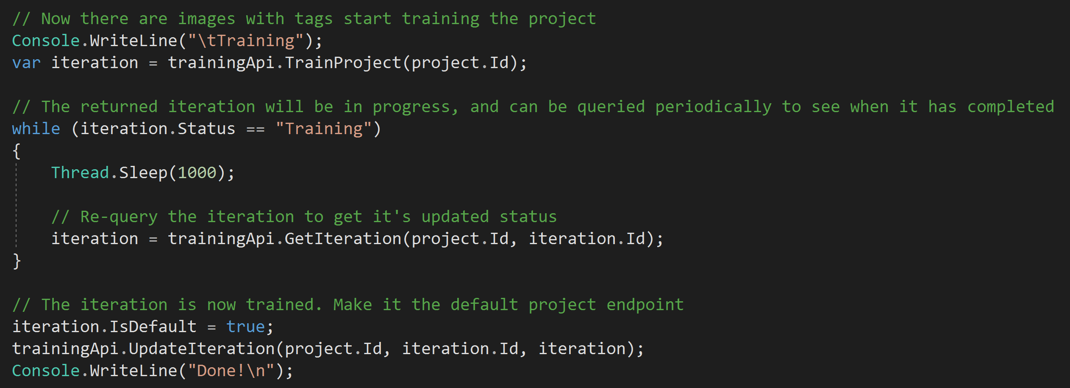
Training the model
Notes:
This page has been intentionally left blank.
The instructor will walk through the code either from the PowerPoint slide or from the source code in Visual Studio.

Slide 27
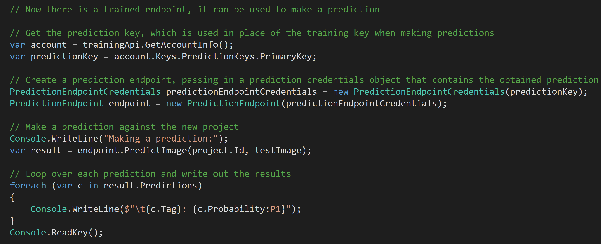
Making Predictions
Notes:
This page has been intentionally left blank.
The instructor will walk through the code either from the PowerPoint slide or from the source code in Visual Studio.

Slide 28
Demo: Training and Predicting a Custom Vision Model
Notes:
In this demonstration, you will see the C# code required to train the classifier with the images that are being uploaded. In addition code will be displayed that will be used to make a predication.
Prerequisites
Previous demo completed
Ensure that the previous demo has been completed
Platform requirements
This example has been developed for the .NET Framework using Visual Studio 2017, Community Edition
Training client library
You may need to install the client library. The easiest way to get the training client library is to get the Microsoft.Cognitive.CustomVision.Training package from nuget.
The Training API key
The training API key allows you to create, manage and train Custom Vision projects programatically. All operations on the website are exposed through this library, allowing you to automate all aspects of the Custom Vision Service. You can obtain a key by creating a project at at the website and finding the key in the setting of the project that you have created. Add the following code as instructed to the code you opened up in the previous demo.
Step 5: Train the project
Now that we've added tags and images to the project, we can train it. Insert the following code after the end of code that you added in step 4.. This creates the first iteration in the project. We can then mark this iteration as the default iteration.
// Now there are images with tags start training the project
Console.WriteLine("\tTraining");
var iteration = trainingApi.TrainProject(project.Id);
// The returned iteration will be in progress, and can be queried periodically to see when it has completed
while (iteration.Status == "Training")
{
Thread.Sleep(1000);
// Re-query the iteration to get it's updated status
iteration = trainingApi.GetIteration(project.Id, iteration.Id);
}
// The iteration is now trained. Make it the default project endpoint
iteration.IsDefault = true;
trainingApi.UpdateIteration(project.Id, iteration.Id, iteration);
Console.WriteLine("Done!\n");
Step 6: Get and use the default prediction endpoint
We are now ready to use the model for prediction. First we obtain the endpoint associated with the default iteration. Then we send a test image to the project using that endpoint. Insert the code after the training code you have just entered.
// Now there is a trained endpoint, it can be used to make a prediction
// Get the prediction key, which is used in place of the training key when making predictions
var account = trainingApi.GetAccountInfo();
var predictionKey = account.Keys.PredictionKeys.PrimaryKey;
// Create a prediction endpoint, passing in a prediction credentials object that contains the obtained prediction key
PredictionEndpointCredentials predictionEndpointCredentials = new PredictionEndpointCredentials(predictionKey);
PredictionEndpoint endpoint = new PredictionEndpoint(predictionEndpointCredentials);
// Make a prediction against the new project
Console.WriteLine("Making a prediction:");
var result = endpoint.PredictImage(project.Id, testImage);
// Loop over each prediction and write out the results
foreach (var c in result.Predictions)
{
Console.WriteLine($"\t{c.Tag}: {c.Probability:P1}");
}
Console.ReadKey();
Step 7: Run the example
Build and run the solution. You will be required to input your training API key into the console app when runing the solution so have this at the ready. The training and prediction of the images can take 2 mins The prediction results appear on the console. the console.

Slide 29
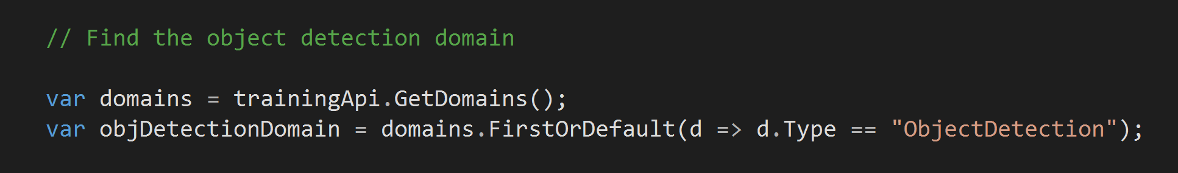
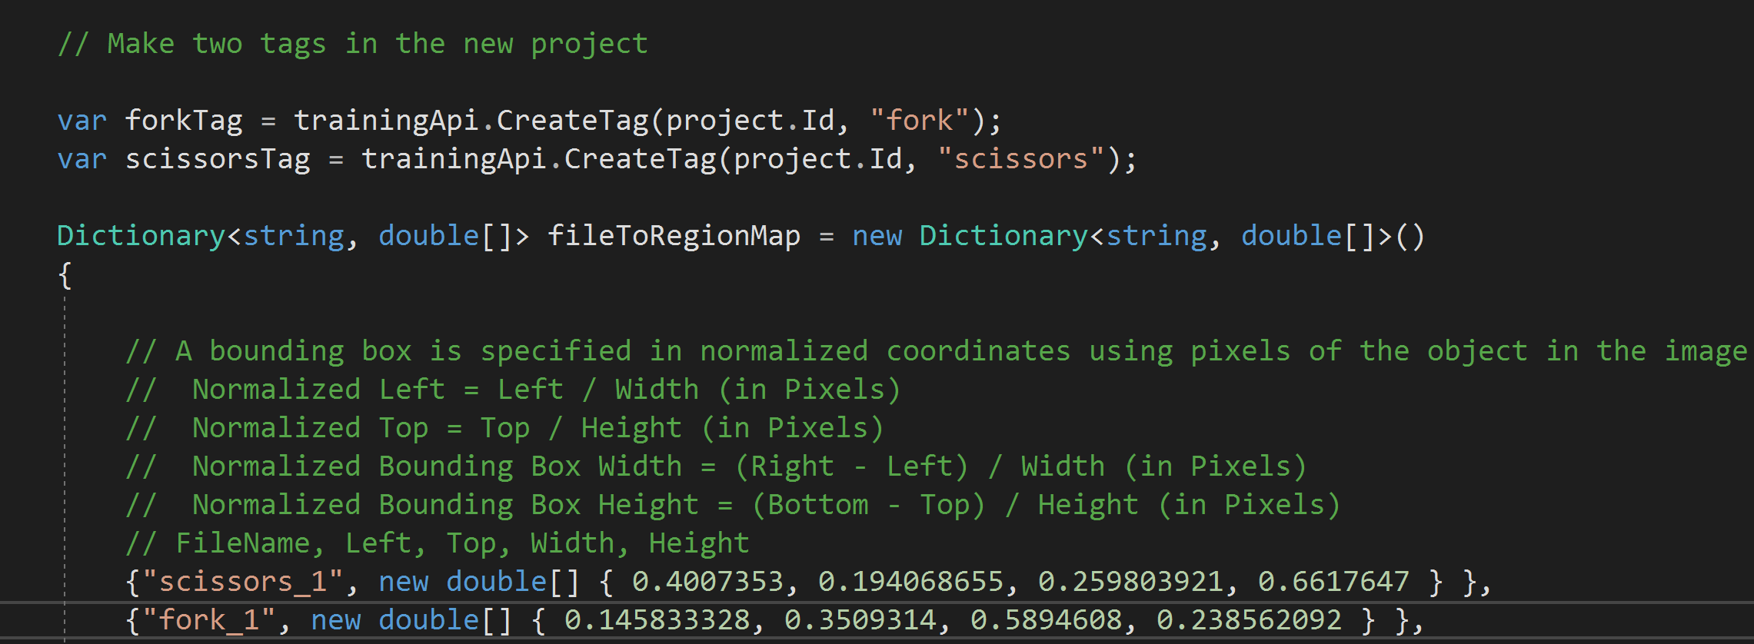
Performing Object Detection
Notes:
This page has been intentionally left blank.
The instructor will walk through the code either from the PowerPoint slide or from the source code in Visual Studio.

Slide 30
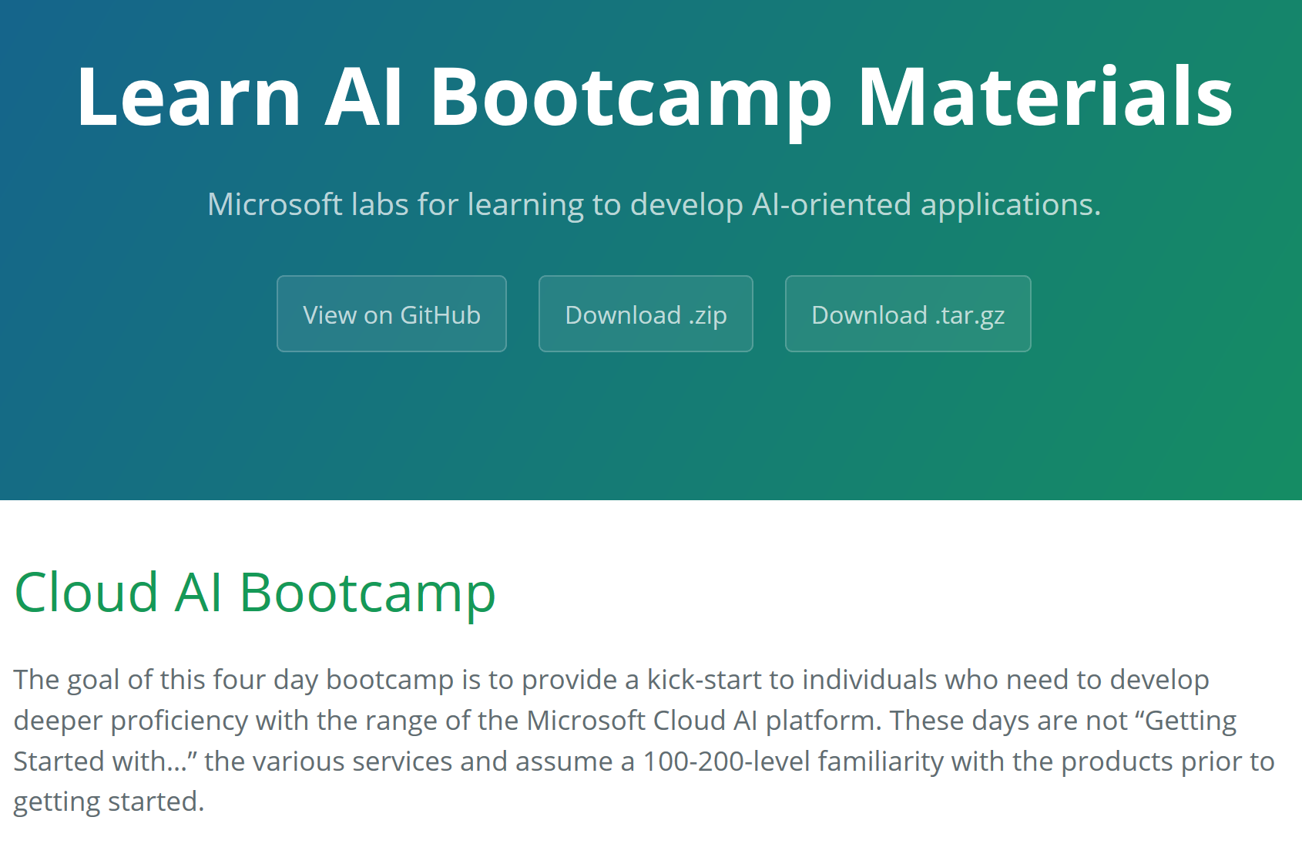

Try out labs on all of these technologies at
https://azure.github.io/LearnAI-Bootcamp/
© 2018 Microsoft Corporation. All rights reserved.

Slide 31
Lab 2:
Modifying a Custom Vision Solution
Notes:
Modifying Custom Vision Solution
In this lab you will take the solution from Demo’s and modify the code to upload a new set of images, add tags to it; train the project and obtain the default prediction endpoint URL for the project. You will then use the endpoint to programmatically test an image. You can use this open source example as a template for building your own app for Windows using the Custom Vision API.
Prerequisites
Platform requirements
This example has been developed for the .NET Framework using Visual Studio 2017, Community Edition
Training client library
You may need to install the client library. The easiest way to get the training client library is to get the Microsoft.Cognitive.CustomVision.Training package from nuget.
The Training API key
The training API key allows you to create, manage and train Custom Vision projects programatically. All operations on the websiteare exposed through this library, allowing you to automate all aspects of the Custom Vision Service. You can obtain a key by creating a project at at the website and finding the key in the setting of the project that you have created.
Lab: Modifying a Custom Vision Application
Step 1: Create a console application and prepare the training key and the images needed for the example.
Start Visual Studio 2017, Community Edition, open the Visual Studio solution named CustomVision.Sample.sln in location \Lab\Starter\Cognitive-CustomVision-Windows\Samples\CustomVision.Sample. This code defines a solution for training images using a custom.ai training key. It then performs a classification prediction on a test image that is uploaded. On opening the project the following code should be displayed from line 35.
using System;
using System.Collections.Generic;
using System.IO;
using System.Linq;
using System.Threading;
using Microsoft.Cognitive.CustomVision;
namespace CustomVision.Sample
{
class Program
{
private static List<MemoryStream> hemlockImages;
private static List<MemoryStream> japaneseCherryImages;
private static MemoryStream testImage;
static void Main(string[] args)
{
// You can either add your training key here, pass it on the command line, or type it in when the program runs
string trainingKey = GetTrainingKey("<your key here>", args);
// Create the Api, passing in a credentials object that contains the training key
TrainingApiCredentials trainingCredentials = new TrainingApiCredentials(trainingKey);
TrainingApi trainingApi = new TrainingApi(trainingCredentials);
// Create a new project
Console.WriteLine("Creating new project:");
var project = trainingApi.CreateProject("My New Project");
// Make two tags in the new project
var hemlockTag = trainingApi.CreateTag(project.Id, "Hemlock");
var japaneseCherryTag = trainingApi.CreateTag(project.Id, "Japanese Cherry");
// Add some images to the tags
Console.WriteLine("\tUploading images");
LoadImagesFromDisk();
// Images can be uploaded one at a time
foreach (var image in hemlockImages)
{
trainingApi.CreateImagesFromData(project.Id, image, new List<string>() { hemlockTag.Id.ToString() });
}
// Or uploaded in a single batch
trainingApi.CreateImagesFromData(project.Id, japaneseCherryImages, new List<Guid>() { japaneseCherryTag.Id });
// Now there are images with tags start training the project
Console.WriteLine("\tTraining");
var iteration = trainingApi.TrainProject(project.Id);
// The returned iteration will be in progress, and can be queried periodically to see when it has completed
while (iteration.Status == "Training")
{
Thread.Sleep(1000);
// Re-query the iteration to get it's updated status
iteration = trainingApi.GetIteration(project.Id, iteration.Id);
}
// The iteration is now trained. Make it the default project endpoint
iteration.IsDefault = true; trainingApi.UpdateIteration(project.Id, iteration.Id, iteration);
Console.WriteLine("Done!\n");
// Now there is a trained endpoint, it can be used to make a prediction
// Get the prediction key, which is used in place of the training key when making predictions
var account = trainingApi.GetAccountInfo();
var predictionKey = account.Keys.PredictionKeys.PrimaryKey;
// Create a prediction endpoint, passing in a prediction credentials object that contains the obtained prediction key
PredictionEndpointCredentials predictionEndpointCredentials = new PredictionEndpointCredentials(predictionKey);
PredictionEndpoint endpoint = new PredictionEndpoint(predictionEndpointCredentials);
// Make a prediction against the new project
Console.WriteLine("Making a prediction:");
var result = endpoint.PredictImage(project.Id, testImage);
// Loop over each prediction and write out the results
foreach (var c in result.Predictions)
{
Console.WriteLine($"\t{c.Tag}: {c.Probability:P1}");
}
Console.ReadKey();
}
private static string GetTrainingKey(string trainingKey, string[] args)
{
if (string.IsNullOrWhiteSpace(trainingKey) || trainingKey.Equals("<your key here>"))
{ if (args.Length >= 1)
{
trainingKey = args[0];
}
while (string.IsNullOrWhiteSpace(trainingKey) || trainingKey.Length != 32)
{
Console.Write("Enter your training key: ");
trainingKey = Console.ReadLine();
}
Console.WriteLine();
}
return trainingKey;
}
private static void LoadImagesFromDisk()
{
// this loads the images to be uploaded from disk into memory
hemlockImages = Directory.GetFiles(@"..\..\..\Images\Hemlock").Select(f => new MemoryStream(File.ReadAllBytes(f))).ToList();
japaneseCherryImages = Directory.GetFiles(@"..\..\..\Images\Japanese Cherry").Select(f => new MemoryStream(File.ReadAllBytes(f))).ToList();
testImage = new MemoryStream(File.ReadAllBytes(@"..\..\..\Images\Test\test_image.jpg"));
}
Step 2: Change the memory stream definition
In line 46 and 48, change the variable names for the list items to match the names defined for the image types
private static List<MemoryStream> AmpImages;
private static List<MemoryStream> GuitarImages
Step 3: Modify a Custom Vision Service project name
Modify Custom Vision Service project name to “My Second Project”, add the following change in the code in your Main() method after the call to LoadImagesFromDisk().
// Create a new project
Console.WriteLine("Creating new project:");
var project = trainingApi.CreateProject("My Second Project");
Step 4: Add tags to your project
Create new tags to your project to distinguish between amps and guitars, insert the following code after the call to CreateProject(”My Second Project”);.
// Make two tags in the new project
var AmpTag = trainingApi.CreateTag(project.Id, "Amp");
var GuitarTag = trainingApi.CreateTag(project.Id, "Guitar");
Step 5: Upload images to the project
To add the images we have in memory to the project, insert the following code after the call to CreateTag(project.Id, "Guitar") method.
// Add some images to the tags
Console.WriteLine("\tUploading images");
LoadImagesFromDisk();
// Images can be uploaded one at a time
foreach (var image in AmpImages)
{
trainingApi.CreateImagesFromData(project.Id, image, new List<string>() { AmpTag.Id.ToString() });
}
// Or uploaded in a single batch
trainingApi.CreateImagesFromData(project.Id, GuitarImages, new List<Guid>() { GuitarTag.Id });
Step 6: Redefine the LoadImagesFromDisk() method
There are a new set of images that is located in the following location: \Lab\Starter\Cognitive-CustomVision-Windows\Samples\CustomImages. In this folder are three folders. The Amp folder contains pictures of amplifiers. The Guitars folder contains pictures of guitars. These folders are used in the training of the classification model. The final folder named test contains a single picture that will be used to perform the prediction.
Modify the code at the end of the Program.cs file on line 145 that makes reference to the new location of the images that are being used in the prediction. The code should look as follows:
// this loads the images to be uploaded from disk into memory
AmpImages = Directory.GetFiles(@"..\..\..\CustomImages\Amps").Select(f => new MemoryStream(File.ReadAllBytes(f))).ToList();
GuitarImages = Directory.GetFiles(@"..\..\..\CustomImages\Guitars").Select(f => new MemoryStream(File.ReadAllBytes(f))).ToList();
testImage = new MemoryStream(File.ReadAllBytes(@"..\..\..\CustomImages\Test\Instrument.jpg"));
Step 7: Run the example
Build and run the solution. You will be required to input your training API key into the console app when runing the solution so have this at the ready. The training and prediction of the images can take 2 mins The prediction results appear on the console.

Slide 32
Lab 3:
(if time permits)
Modifying a Custom Vision Solution
Notes:
(If time permits)
Modifying Custom Vision API C# Tutorial
In this lab you will take the solution from Lab 2 and modify the code to upload a new set of images, add tags to it; train the project and obtain the default prediction endpoint URL for the project. You will then use the endpoint to programmatically test an image. You can use this open source example as a template for building your own app for Windows using the Custom Vision AP. This lab deliberately has limited instructions, as it should build on the knowledge gained in Lab 2. No code is provided in this lab.
Prerequisites
Lab 2 completed
This instructions in this example relies on the fact that the previous lab has been completed.
Platform requirements
This example has been developed for the .NET Framework using Visual Studio 2015, Community Edition
Training client library
You may need to install the client library. The easiest way to get the training client library is to get the Microsoft.Cognitive.CustomVision.Training package from nuget.
The Training API key
The training API key allows you to create, manage and train Custom Vision projects programatically. All operations on the websiteare exposed through this library, allowing you to automate all aspects of the Custom Vision Service. You can obtain a key by creating a project at at the website and finding the key in the setting of the project that you have created.
Lab: Modifying a Custom Vision Application
Step 1: Create a console application and prepare the training key and the images needed for the example.
Start Visual Studio 2017, Community Edition, open the Visual Studio solution named CustomVision.Sample.sln in location \Lab\Starter\Cognitive-CustomVision-Windows\Samples\CustomVision.Sample. This code defines a solution for training images using a custom.ai training key. The images for this particular lab can be found at \Lab\Starter in a folder called LabImages. Use these images as you see fit. Once used, the solution performs a classification prediction on a test image that is uploaded. On opening the project the following code should be displayed from line 35.
Step 2: Change the memory stream definition
Change the variable names for the list items to match the names defined for the image types
Step 3: Modify a Custom Vision Service project name
Modify Custom Vision Service project name to “My Third Project”, add the following change in the code in your Main() method after the call to LoadImagesFromDisk().
Step 4: Add tags to your project
Create new tags to your project to distinguish between pools and tracks, insert the following code after the call to CreateProject(”My Third Project”);.
Step 5: Upload images to the project
To add the images we have in memory to the project, insert the following code after the call to CreateTag(project.Id, "Tracks") method.
Step 6: Redefine the LoadImagesFromDisk() method
Use the images from the Images folder In this folder are three folders. The Pools folder contains pictures of swimming pools. The Tracks folder contains pictures of athletics tracks. These folders are used in the training of the classification model. The final folder named test contains a single picture named Sport.jpg that will be used to perform the prediction.
Modify the code at the end of the Program.cs file on line 145 that makes reference to the new location of the images that are being used in the prediction. The code should look as follows:
Step 7: Run the example
Build and run the solution. You will be required to input your training API key into the console app when runing the solution so have this at the ready. The training and prediction of the images can take 2 mins The prediction results appear on the console

Slide 33
Conclusion

Slide 34
Vision
From faces to feelings, allow your apps to understand images and video
Microsoft Cognitive Services
Give your apps a human side
Speech
Hear and speak to your users by filtering noise, identifying speakers, and understanding intent
Language
Process text and learn how to recognize what users want
Knowledge
Tap into rich knowledge amassed from the web, academia, or your own data
Search
Access billions of web pages, images, videos, and news with the power of Bing APIs
Notes:
Manage Cognitive Services in the Azure Cloud or test them with temporary access.
https://azure.microsoft.com/en-gb/services/cognitive-services/directory/

Slide 35
Cognitive Services – Vision APIs
Vision
Computer Vision
Face
Video
Custom Vision
Notes:
Cognitive Services has a number of API’s around vision including:
Custom Vision Service
PREVIEW Easily customise your own state-of-the-art computer vision models for your unique use case
Try Custom Vision Service
Computer Vision API
Distill actionable information from images
Try Computer Vision API | Use with an Azure subscription
Face API
Detect, identify, analyse, organise and tag faces in photos
Try Face API | Use with an Azure subscription
Content moderator
Automated image, text and video moderation
Use with an Azure subscription
Emotion API
PREVIEW Personalise user experiences with emotion recognition
Try Emotion API | Use with an Azure subscription
Video API
PREVIEW Intelligent video processing
Use with an Azure subscription
Video Indexer
PREVIEW Unlock video insights
Try Video Indexer
Reference:
https://azure.microsoft.com/en-gb/services/cognitive-services/directory/vision/

Slide 36
Custom Vision website
Notes:
https://customvision.ai

Slide 37
Custom Vision Client Library’s
Notes:
Two client libraries that can be used to develop a Custom Vision application:
Microsoft.Cognitive.CustomVision.Training
Gives you full access to the Custom Vision training SDK, allowing you to programatically perform any management operations possible through the Custom Vision website.
Reference:
https://www.nuget.org/packages/Microsoft.Cognitive.CustomVision.Training/
Microsoft.Cognitive.CustomVision.Prediction
Allows you to programmatically predict an image against a trained Custom Vision endpoint.
Reference:
https://www.nuget.org/packages/Microsoft.Cognitive.CustomVision.Prediction/

Slide 38
Thank you @ctesta_oneill https://www.linkedin.com/in/ctestaoneill/ http://learnanalytics.microsoft.com/

Slide 39
Information in this document, including URL and other Internet Web site references, is subject to change without notice. Unless otherwise noted, the companies, organizations, products, domain names, e-mail addresses, logos, people, places, and events depicted herein are fictitious, and no association with any real company, organization, product, domain name, e-mail address, logo, person, place, or event is intended or should be inferred. Complying with all applicable copyright laws is the responsibility of the user. Without limiting the rights under copyright, no part of this document may be reproduced, stored in or introduced into a retrieval system, or transmitted in any form or by any means (electronic, mechanical, photocopying, recording, or otherwise), or for any purpose, without the express written permission of Microsoft Corporation.
For more information, see Microsoft Copyright Permissions at http://www.microsoft.com/permission
Microsoft may have patents, patent applications, trademarks, copyrights, or other intellectual property rights covering subject matter in this document. Except as expressly provided in any written license agreement from Microsoft, the furnishing of this document does not give you any license to these patents, trademarks, copyrights, or other intellectual property.
The Microsoft company name and Microsoft products mentioned herein may be either registered trademarks or trademarks of Microsoft Corporation in the United States and/or other countries. The names of actual companies and products mentioned herein may be the trademarks of their respective owners.
This document reflects current views and assumptions as of the date of development and is subject to change. Actual and future results and trends may differ materially from any forward-looking statements. Microsoft assumes no responsibility for errors or omissions in the materials.
THIS DOCUMENT IS FOR INFORMATIONAL AND TRAINING PURPOSES ONLY AND IS PROVIDED "AS IS" WITHOUT WARRANTY OF ANY KIND, WHETHER EXPRESS OR IMPLIED, INCLUDING BUT NOT LIMITED TO THE IMPLIED WARRANTIES OF MERCHANTABILITY, FITNESS FOR A PARTICULAR PURPOSE, AND NON-INFRINGEMENT.

